Slide 1
UMass Lowell Computer Science 91.404
Analysis of Algorithms
Prof. Karen Daniels
Spring, 2008
Lecture 1
Introduction/Overview
Text: Chapters 1, 2
Mon. 1/28/08

Slide 2
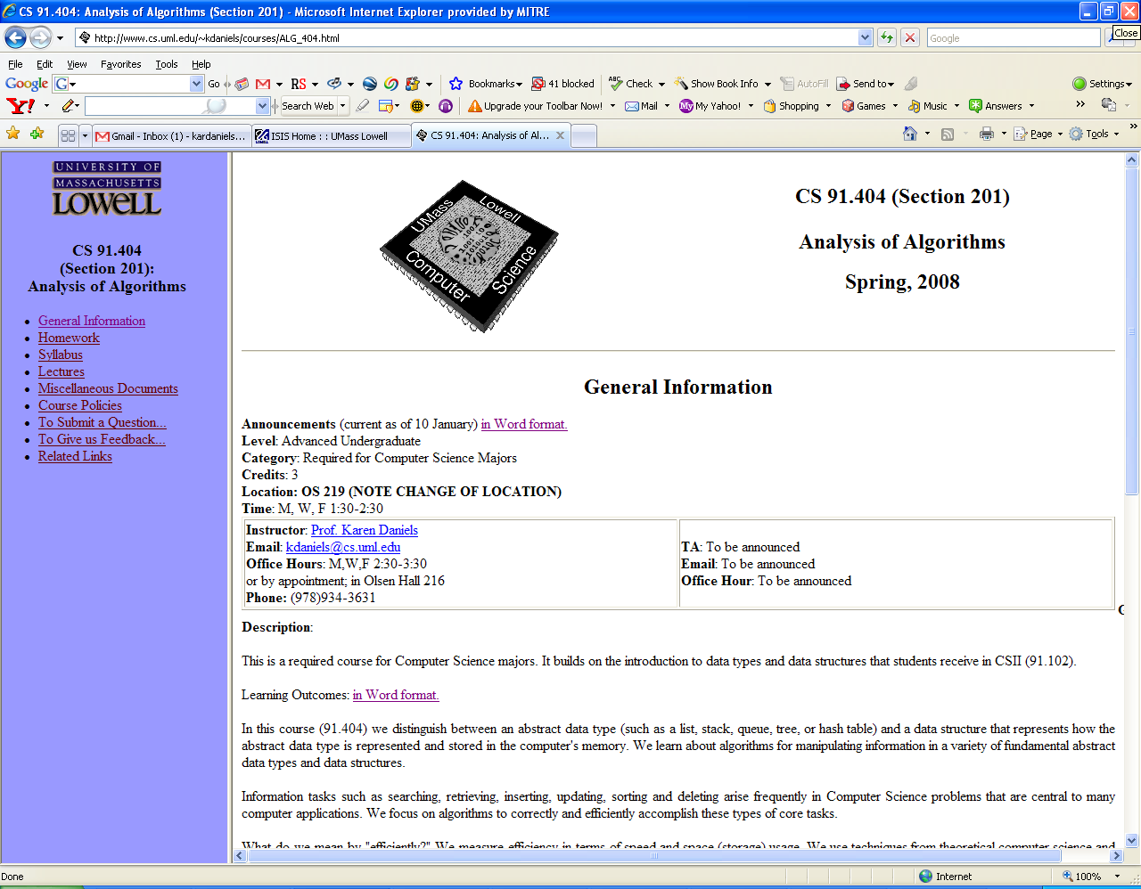
Web Page
Web Page
http://www.cs.uml.edu/~kdaniels/courses/ALG_404.html

Slide 3


Nature of the Course
Core course: required for all CS majors
Advanced undergraduate level
  Graduate students take separate course (91.503)
No programming required
  “Pencil-and-paper” exercises
  Lectures supplemented by:
    Programs
    Real-world examples

Slide 4

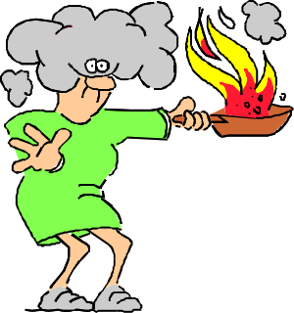

What’s It All About?
Algorithm:
  steps for the computer to follow to solve a problem
  well-defined computational procedure that transforms input into output
Some of our goals:
  recognize structure of some common problems
  understand important characteristics of algorithms to solve common problems
  select appropriate algorithm to solve a problem
  tailor existing algorithms
  create new algorithms

Slide 5


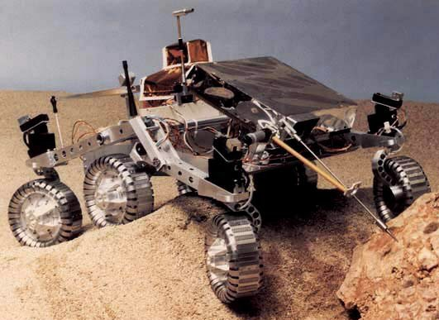
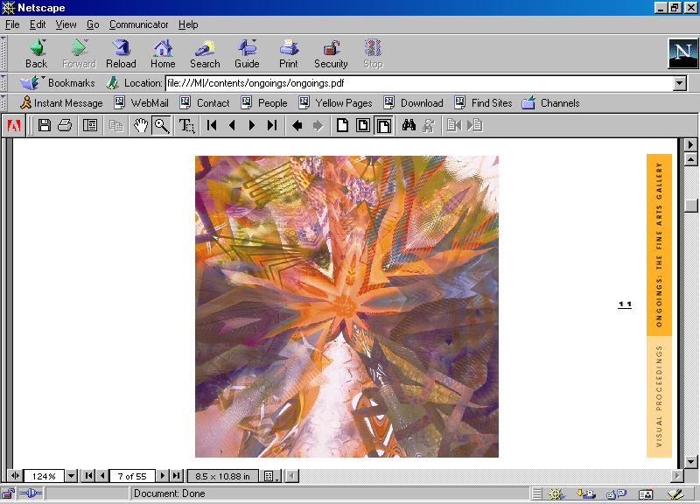
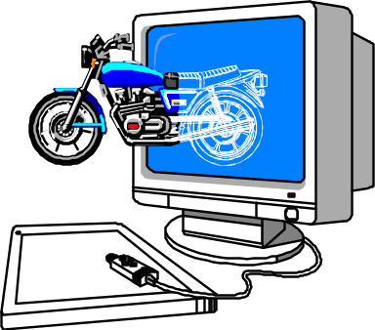
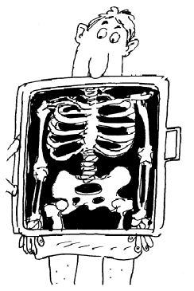

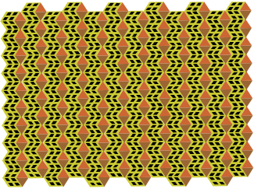
Some Algorithm Application Areas
Robotics
Bioinformatics
Telecommunications
Design
Analyze
Algorithms
Apply
Computer Graphics
Medical Imaging

Slide 6
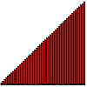
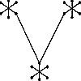
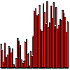
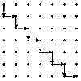
Some Typical Problems
Minimum Spanning Tree
  Input: Graph G = (V,E) with weighted edges
  Problem: Find subset of E of G of minimum weight which forms a tree on V
Shortest Path
  Input: Edge-weighted graph G , with start vertex s and end vertex t
  Problem: Find the shortest path from s to t in G
Sorting
  Input: Set of items
  Problem: Arrange items “in order”
Median finding
  Input: Set of numbers or keys
  Problem: Find item smaller than half of items and bigger than half of items
SOURCE: Steve Skiena’s Algorithm Design Manual
(for problem descriptions, see graphics gallery at http://www.cs.sunysb.edu/~algorith)

Slide 7
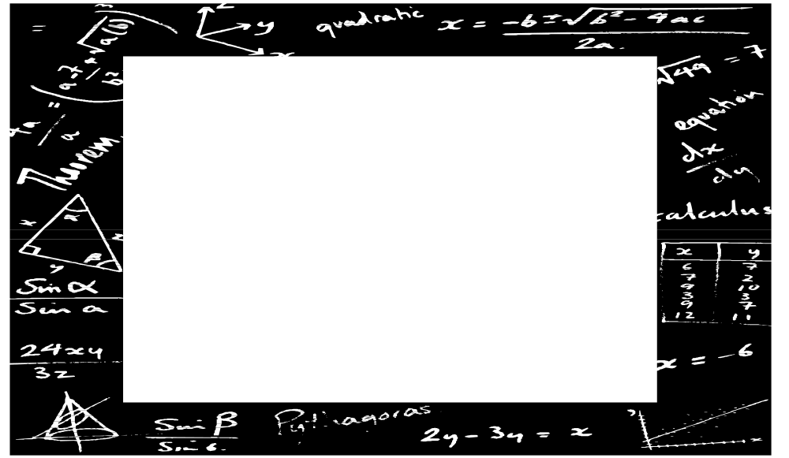
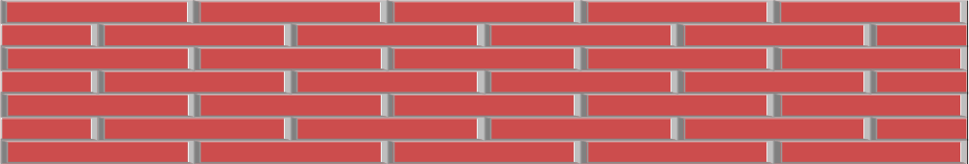
Tools of the Trade
Algorithm Design Patterns such as:
  divide-and-conquer
Data Structures such as:
  trees, linked lists, hash tables, graphs
Algorithm Analysis Techniques such as:
  asymptotic analysis
  probabilistic analysis
Summations
MATH
Permutations
Proofs
Combinations
Sets
Logarithms
Growth of Functions
Probability
Recurrences

Slide 8
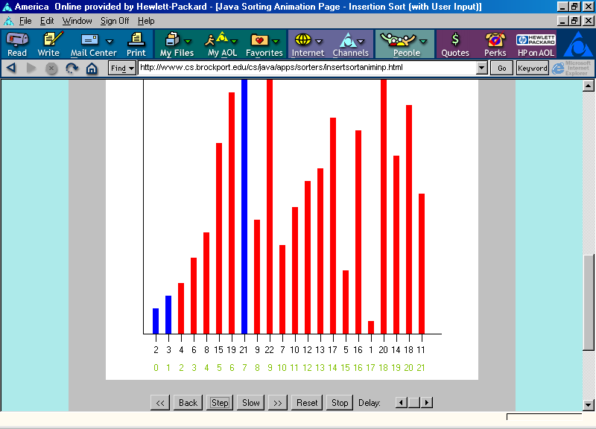
Tools of the Trade: (continued) Algorithm Animation
Formerly http://www.cs.brockport.edu/cs/java/apps/sorters/insertsortaniminp.html

Slide 9
What are we measuring?
Some Analysis Criteria:
  Scope
    The problem itself?
    A particular algorithm that solves the problem?
  “Dimension”
    Time Complexity? Space Complexity?
  Type of Bound
    Upper? Lower? Both?
  Type of Input
    Best-Case? Average-Case? Worst-Case?
  Type of Implementation
    Choice of Data Structure

Slide 10
Prerequisites
Computing I (91.101)
Computing II (91.102)
Discrete Math I & II (92.321, 92.322)
Statistics for Scientists and Engineers (92.386)
Calculus I-II (92.131-132)
Summations
MATH
Permutations
Proofs
Combinations
Sets
Logarithms
Growth of Functions
Probability
Recurrences

Slide 11
Course Structure: 5 Parts
Foundations
  Analyzing & Designing Algorithms, Growth of Functions, Recurrences, Probability & Randomized Algorithms
Sorting
  Heapsort, Priority Queues, Quicksort, Sorting in Linear Time
Data Structures
  Stacks and Queues, Linked Lists, Introduction to Trees, Hash Tables, Binary Search Trees, Balancing Trees: Red-Black Trees
Advanced Techniques
  Dynamic Programming, Greedy Algorithms
Graph Algorithms
  DFS, BFS, Topological Sort, MST, Shortest paths
Part 1
Part 2
Part 3
Part 4
Part 5

Slide 12

Textbook
Required:
  Introduction to Algorithms
    by T.H. Corman, C.E. Leiserson, R.L. Rivest
    McGraw-Hill
    2001
    ISBN 0-07-013151-1
    see course web site (MiscDocuments) for errata (1st edition)
2001 Edition
Ordered for UML bookstore

Slide 13
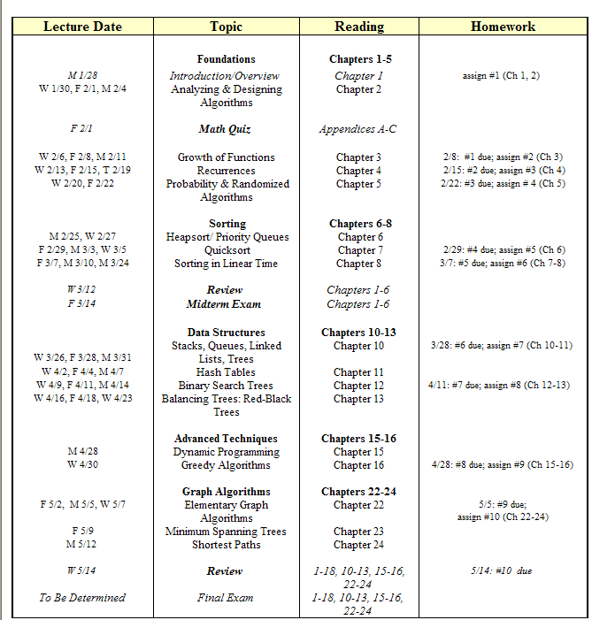
Syllabus (current plan)
Revised for Fall, 2001 in accordance with ACM Computer Science Computing Curricula 2001, Steelman Draft, August, 2001.

Slide 14
CS Theory Math Review Sheet
The Most Relevant Parts...
p. 1
  O, Θ, Ω definitions
  Series
  Combinations
p. 2 Recurrences & Master Method
p. 3
  Probability
  Factorial
  Logs
  Stirling’s approx
p. 4 Matrices
p. 5 Graph Theory
p. 6 Calculus
  Product, Quotient rules
  Integration, Differentiation
  Logs
p. 8 Finite Calculus
p. 9 Series
Math fact sheet (courtesy of Prof. Costello) is on our web site.

Slide 15

Important Dates
Math Quiz (closed book) Friday, 2/1
Midterm Exam (Chapters 1-6): Friday, 3/14
Final Exam: TBA

Slide 16
Grading
Homework 35%
Midterm (chapters 1-6, open book & notes) 30%
Discretionary (attendance, participation, math quiz) 5%
Final Exam (cumulative, open book & notes) 30%

